Slide 1

Decision Tree Concepts
Presented by: Sanjeev Kumar Pandey
Enrolment No: MT23AAI001
Faculty: Dr. Arvind Choudhary
ML Algo : Teacher’s Assessment

Slide 2
Agenda
2
Decision Trees Introduction
Splitting Internal Nodes
Decision Tree Example
Entropy and Information Gain
Growth Control of Tree
Use Cases of Decision Tree
Code Example

Slide 3
Decision Trees
A Decision Tree (DT) defines a hierarchy of rules to make a prediction
Root and internal nodes test rules. Leaf nodes make predictions
Decision Tree (DT) learning is about learning such a tree from labeled data
Root Node
Body
temp.
Warm
Cold
Non-mammal
An Internal Node
A Leaf Node
Gives
birth
Yes
No
Mammal
Non-mammal

Slide 4
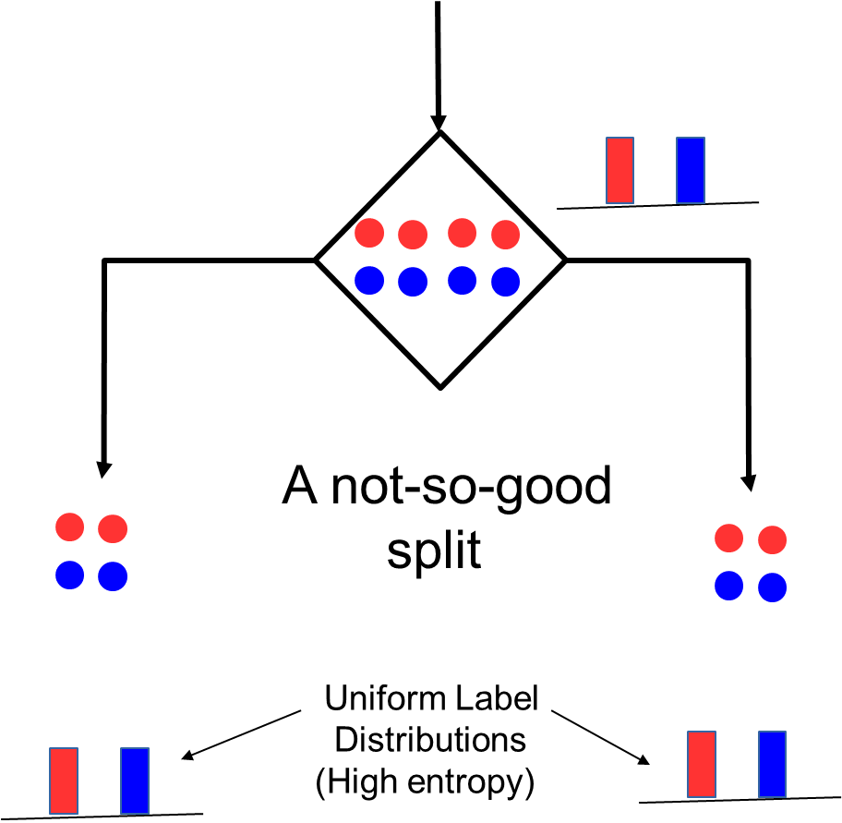
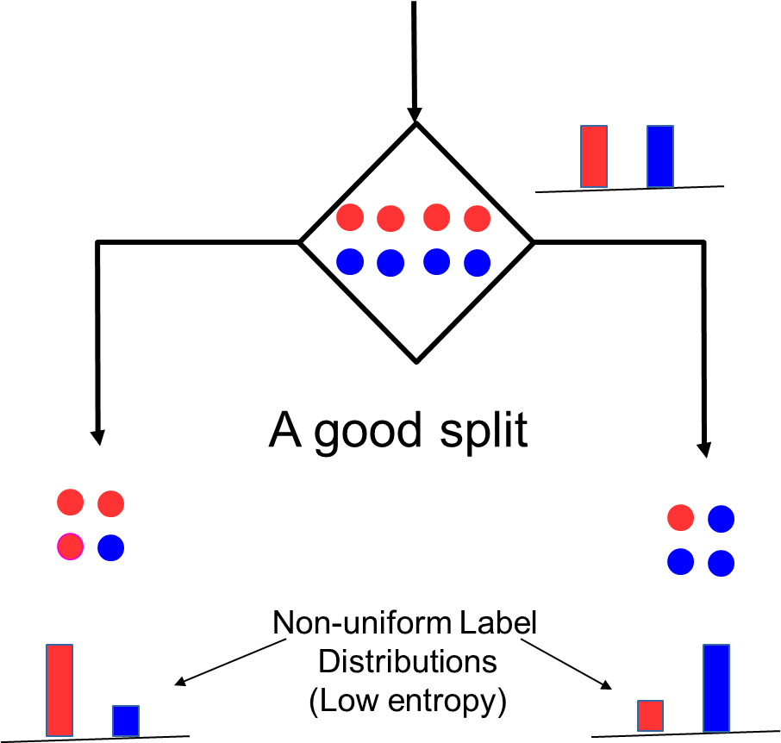
How to Split at Internal Nodes?
4
Recall that each internal node receives a subset of all the training inputs
Regardless of the criterion, the split should result in as “pure” groups as possible
A pure group means that the majority of the inputs have the same label/output
For classification problems (discrete outputs), entropy is a measure of purity
Low entropy ⇒ high purity (less uniform label distribution)
Splits that give the largest reduction (before split vs after split) in entropy are preferred (this reduction is also known as “information gain”)

Slide 5
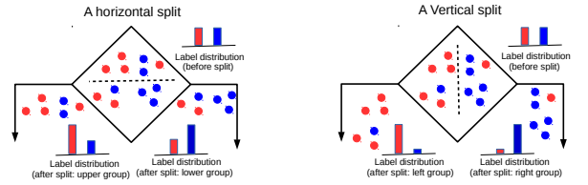
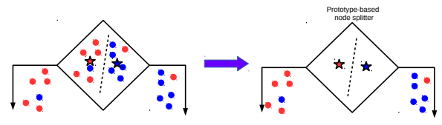
Techniques to Split at Internal Nodes
5
Each internal node decides which outgoing branch an input should be sent to
This decision/split can be done using various ways, e.g.,
Testing the value of a single feature at a time (such internal node called “Decision Stump”)
See here for more details
Learning a classifier (e.g., LwP or some more sophisticated classifier)
DT methods based on testing a single feature at each internal node are faster and more popular (e.g., ID3, C4.5 algos)
With this approach, all features and all possible values of each feature need to be evaluated in selecting the feature to be tested at each internal node
DT methods based on learning and using a separate classifier at each internal node are less common. But this approach can be very powerful and are sometimes used in some advanced DT methods

Slide 6
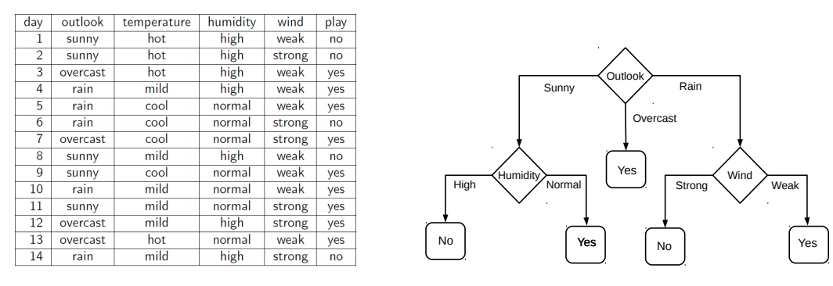
Decision Tree Construction: An Example
6
Each input (Saturday) has 4 categorical features: Outlook, Temp., Humidity, Wind
A binary classification problem (play vs no-play on a Saturday). Assume each internal node will test the value of one of the features
“outlook” is at root node as out of all the 4 features, “outlook” is the most informative as it has the highest information gain as the root node

Slide 7
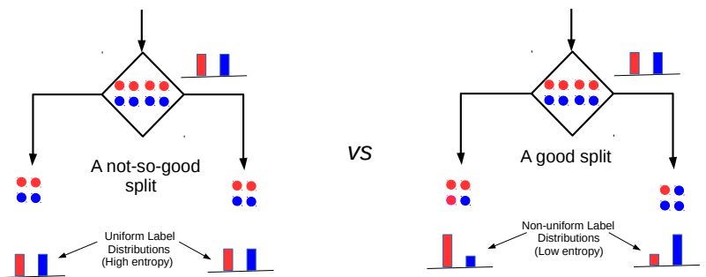


Entropy and Information Gain
7
Assume a set of labelled inputs $S$ from C classes, $p_{c}$ as fraction of class c inputs
Entropy of the set $S$ is defined as $H(S)=−\sum_{c∈C}{p_{c} log p_{c}}$
Suppose a rule splits $S$ into two smaller disjoint sets $S_{1}$ and $S_{2}$
Reduction in entropy after the split is called information gain
$IG=H\left(S\right)− \frac{\left|S_{1}\right|}{\left|S\right|}H\left(S_{1}\right)$ $− \frac{\left|S_{2}\right|}{\left|S\right|}H\left(S_{2}\right)$
This split has a low IG
(in fact zero IG)
This split has higher IG

Slide 8
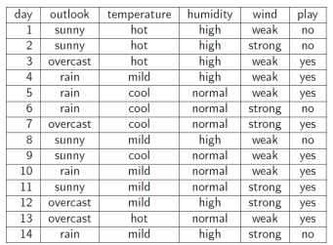
Entropy and Information Gain
8
Let’s use IG based criterion to construct a DT for the Tennis example
At root node, let’s compute IG of each of the 4 features
Consider feature “wind”. Root contains all examples S = [9+,5-]
S_{weak} = [6+, 2−] ⇒ H(S_{weak} ) = 0.811
S_{strong} = [3+, 3−] ⇒ H(S_{strong}) = 1
Likewise, at root: IG(S, outlook) = 0.246, IG(S, humidity) = 0.151, IG(S,temp) = 0.029
Thus we choose “outlook” feature to be tested at the root node
Now how to grow the DT, i.e., what to do at the next level? Which feature to test next?
Rule: Iterate - for each child node, select the feature with the highest IG
$$\text{H}\text{(}\text{S} \text{) =}\text{ −(9/14) }\text{log}\text{2}\text{(9/14) − (5/14) }\text{lo}\text{g}\text{2}\text{(5/14) = 0.94}$$
$IG(S,wind)=H\left(S\right)− \frac{\left|S_{weak}\right|}{\left|S\right|}H\left(S_{weak}\right)$ $− \frac{\left|S_{strong}\right|}{\left|S\right|}H\left(S_{strong}\right)$ = 0.94 − 8/14 ∗ 0.811 − 6/14 ∗ 1 = 0.048

Slide 9
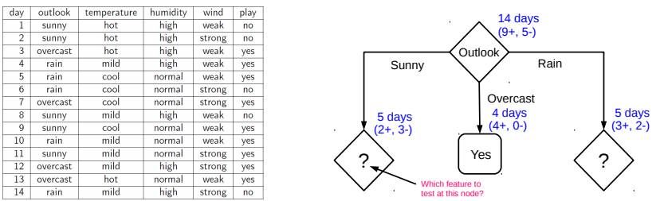
Growing the tree
9
Proceeding as before, for level 2, left node, we can verify that
IG(S,temp) = 0.570, IG(S, humidity) = 0.970, IG(S, wind) = 0.019
Thus humidity chosen as the feature to be tested at level 2, left node
No need to expand the middle node (already “pure” - all “yes” training examples )
Can also verify that wind has the largest IG for the right node
Note: If a feature has already been tested along a path earlier, we don’t consider it again

Slide 10
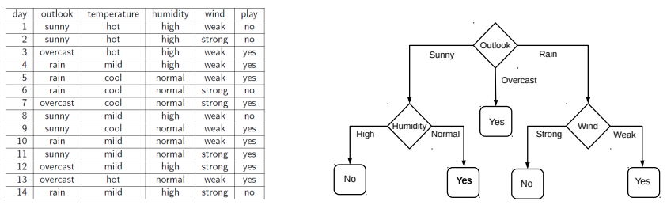
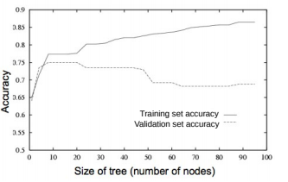
When to stop growing the tree?
10
Stop expanding a node further (i.e., make it a leaf node) when
It consist of all training examples having the same label (the node becomes “pure”)
We run out of features to test along the path to that node
The DT starts to overfit (can be checked by monitoring
the validation set accuracy)
Important: 100 % Purity is not madatory
It is okay to have a leaf node that is not fully pure, e.g., this
At test inputs that reach an impure leaf, can predict probability of belonging to each class (in above example, p(red) = 3/8, p(green) = 5/8), or simply predict the majority label
OR

Slide 11
Use Cases of Decision Tree
11
Decision Trees in Healthcare
In the healthcare sector, decision trees have been used to develop predictive models for a wide range of outcomes, from predicting patient readmissions to identifying risk factors for serious diseases.
Decision Trees in Finance
In the finance sector, decision trees are used in a variety of ways, from predicting stock market trends to assessing the risk of lending to a particular individual or company.
Decision Trees in Marketing
In the field of marketing, decision trees are used to predict customer behaviour and to develop targeted marketing campaigns.
Decision Tree offer a visual and intuitive way to make predictions based on historical data, making them a popular choice for both classification and regression tasks.

